Slide 1




Hungry Terps

Slide 2

Users
Starbucks
Reviewers

Slide 3




Data Source

Slide 4


Our Mission
To analyze the reviews and tips from customers to evaluate Starbucks’ coffeehouses in the College Park
area and improve business based on the feedback provided.
To determine the Starbucks branch with the highest customer rating.
To find the reviews of the highest-rated Starbucks branch in order to improve other branches.
To find negative reviews in order to get feedback and improve.
To find the peak hours when customers visit Starbucks to be well prepared and avoid under-staffing.

Slide 5

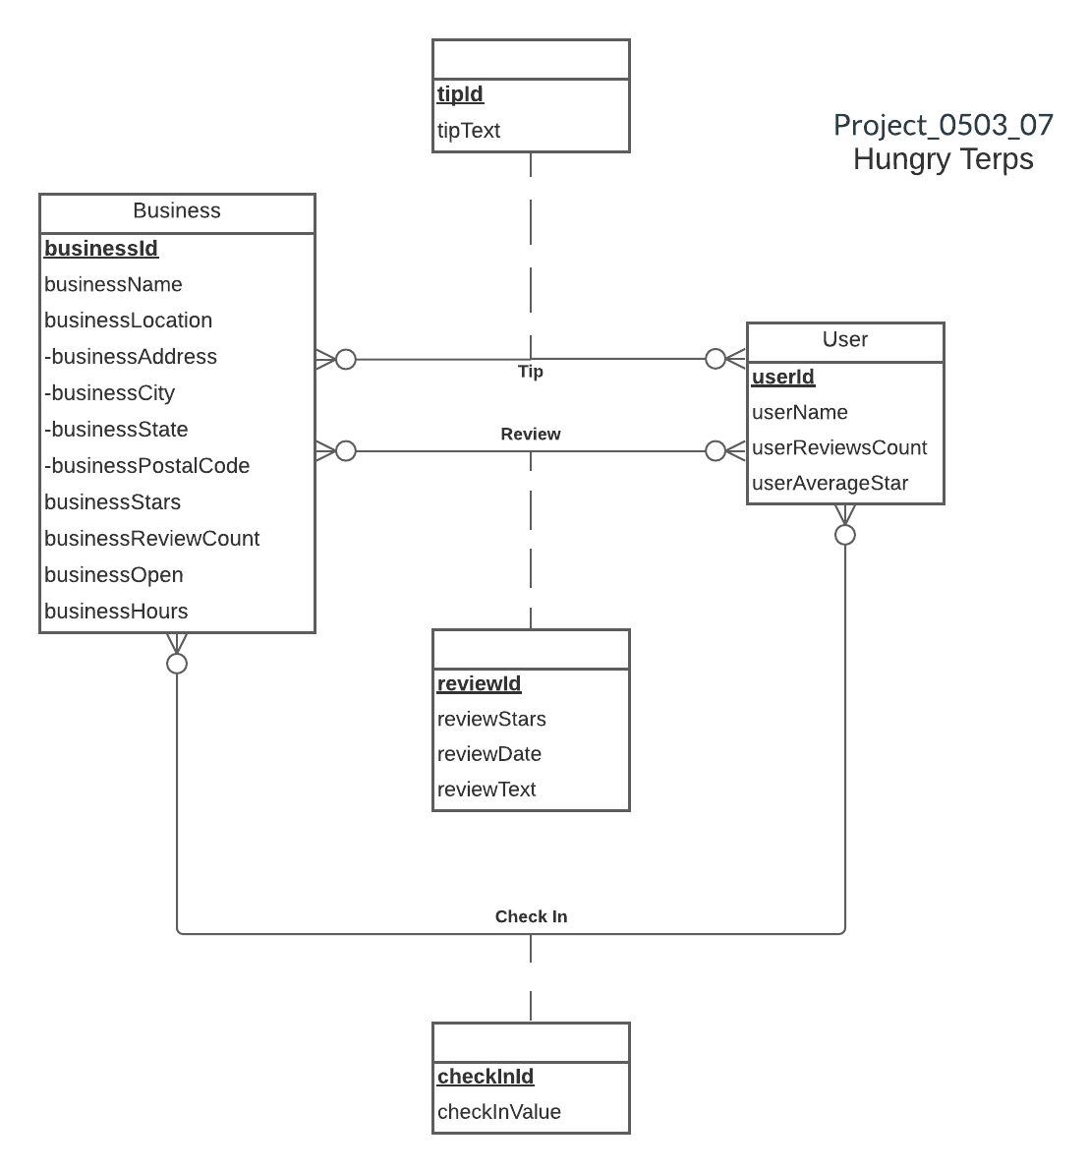

ER Diagram

Slide 6

Relational Schema
Business
(businessId, businessName, businessAddress, businessCity, businessState, businessPostalCode, businessStars, businessReviewCount, businessOpen, businessHours)
User
(userId, userName, userReviewCount, userAverageStars)
Review
(reviewId, reviewStars, reviewDate, reviewText, businessId, userId)
CheckIn
(checkInId, checkInValue, businessId, userId)
Tip
(tipId, tipText, businessId, userId)

Slide 7
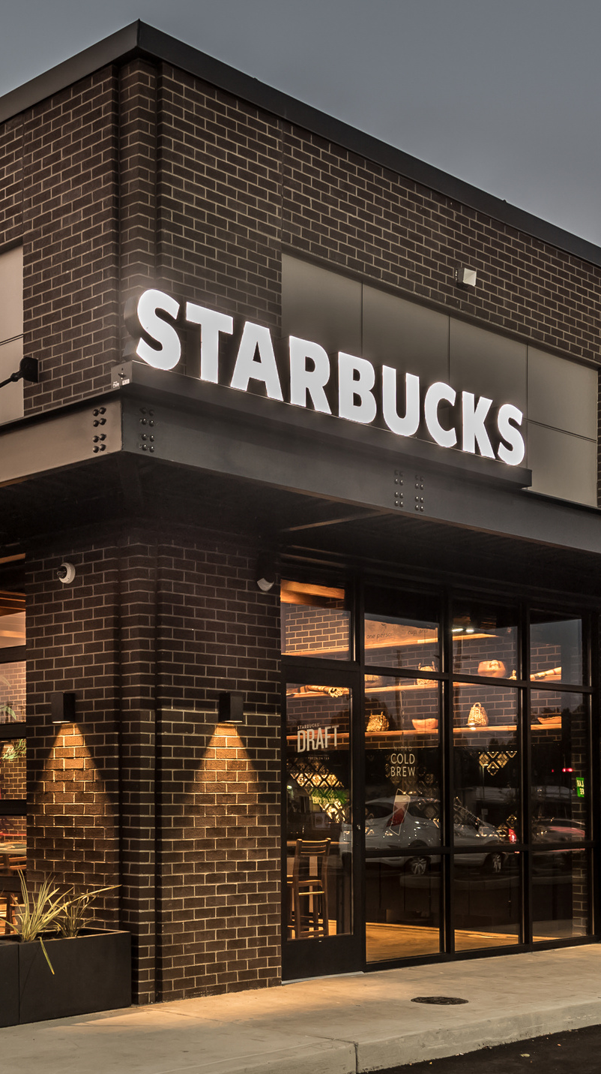

Physical Database Design
Review Table
CREATE TABLE [Terp.Review] (
reviewId VARCHAR(6) NOT NULL,
userId VARCHAR (6) NOT NULL,
businessId VARCHAR (6) NOT NULL,
reviewStars INT,
reviewDate DATE,
reviewText VARCHAR (5000),
CONSTRAINT pk_Review_reviewId PRIMARY KEY (reviewId),
CONSTRAINT fk_Review_userId FOREIGN KEY (userId)
REFERENCES [Terp.User] (userId)
ON DELETE CASCADE ON UPDATE CASCADE,
CONSTRAINT fk_Review_businessId FOREIGN KEY (businessId)
REFERENCES [Terp.Business] (businessId)
ON DELETE CASCADE ON UPDATE CASCADE )

Slide 8

Use Cases

Slide 9

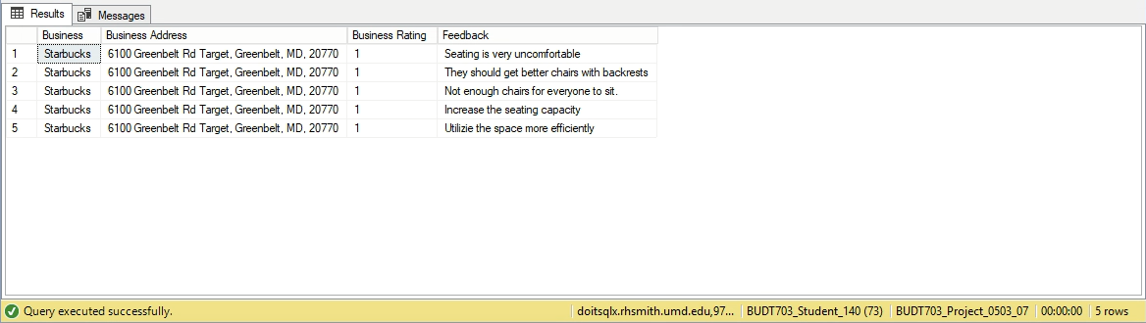

Feedback to improve lowest-rated branch.
CREATE VIEW dbo.User_tips AS
Select b.businessName AS 'Business',
CONCAT(b.businessAddress, ', ', b.businessCity, ', ',
b.businessState, ', ',b.businessPostalCode) AS 'Business Address',
b.businessStars AS 'Business Rating', t.tipText AS 'Feedback'
from [dbo].[Terp.Business] b inner join [dbo].[Terp.Tip] t on
b.businessId = t.businessId
where b.businessStars = (Select min(businessStars) from
[dbo].[Terp.Business] ) ;
SELECT * FROM dbo.User_tips;

Slide 10
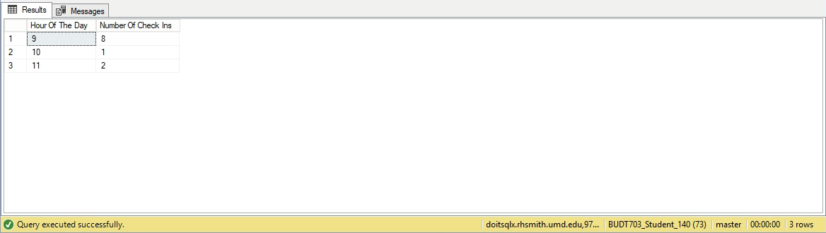
To get feedback of the lowest-rated branch in order to improve.
CREATE VIEW dbo.Peak_hours AS
(Select DATEPART(HOUR, [checkInValue]) AS 'Hour Of The Day'
, COUNT(*) AS 'Number Of Check Ins’ FROM
[BUDT703_Project_0503_07].[dbo].[Terp.CheckIn]
GROUP BY DATEPART(HOUR, [checkInValue]));
SELECT * FROM dbo.Peak_hours;

Slide 11
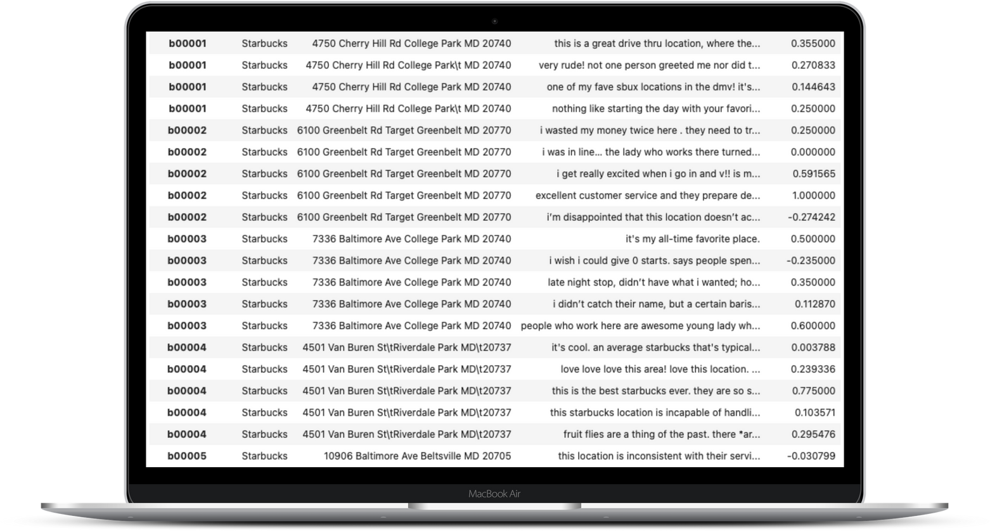


Sentiment Analysis
Determine polarity of reviews
Better understand customer sentiment

Slide 12
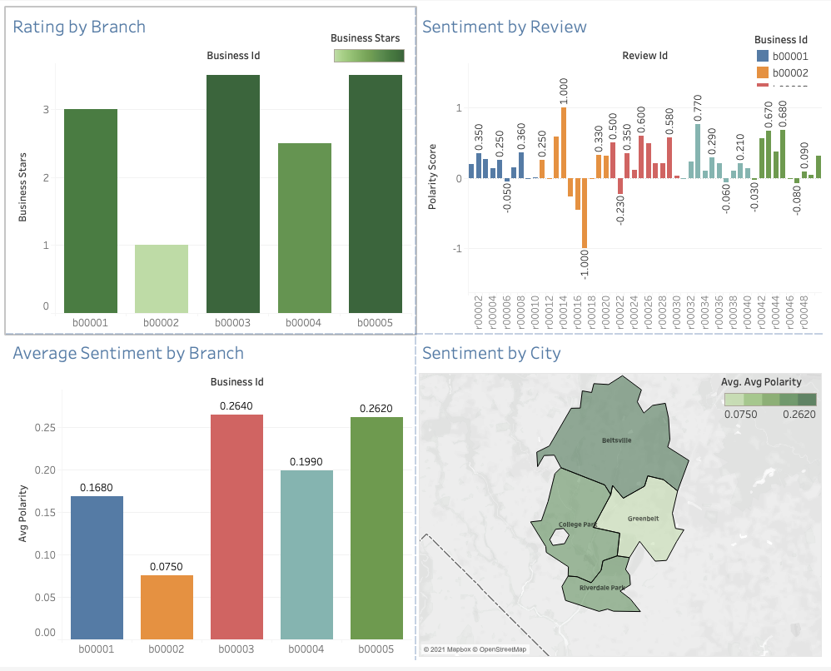
Dashboard

Slide 13

Thank you!

